Slide 1



April 24, 2019
3

Slide 2


MSBI DEVELOPER
Course
S16E24
April 30, 2016 by Andrey Potapov

Slide 3
In Previous part: S16E23 AGENDA
!!! Configuration in Project DM (thanks to Vladimir)
!!! ETL Deployment and Testing
Extending SSAS Cubes
Defining Attribute Relationships
Creating and Modifying User Dimension Hierarchies
Associating Dimensions to Measures Groups
Selecting Relationship Types

Slide 4
In Previous part: S16E23 AGENDA
Creating KPIs, Actions, Translations, and Perspectives
Understanding KPI value, Goal, Status, and Trend Properties
Additional KPI Properties
Creating KPIs, Viewing KPIs
Implementing Actions
Localizing Cubes Through Translations
Implementing Cubes Perspectives

Slide 5
S16E24 AGENDA
Creating Calculations and Queries by Using MDX
Understanding MDX syntax
Applying MDX Functions
Creating Calculated Members
Defining Named Sets
Parent child user hierarchies

Slide 6
Creating Calculations and Queries by Using MDX
Parent child user hierarchies

Slide 7
Creating Calculations and Queries by Using MDX
Parent child user hierarchies
DEMO

Slide 8
Creating Calculations and Queries by Using MDX
Understanding MDX syntax
Thanks to Alexandra Moskovko
Как понять этот ваш MDX и не сломать мозг?

Slide 9
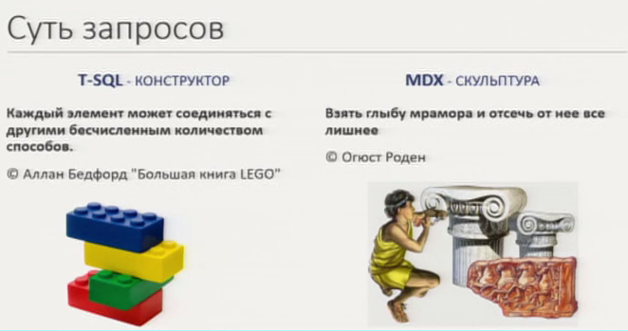
Creating Calculations and Queries by Using MDX
Understanding MDX syntax
DEMO

Slide 10
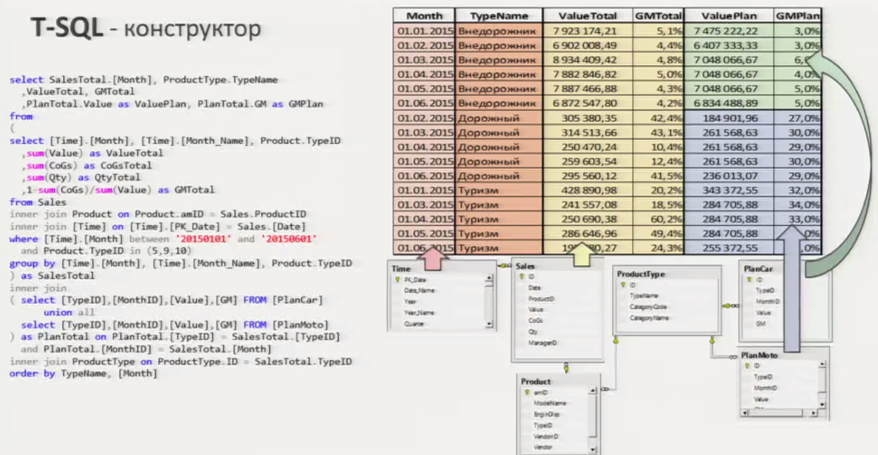
Creating Calculations and Queries by Using MDX
Understanding MDX syntax
DEMO

Slide 11
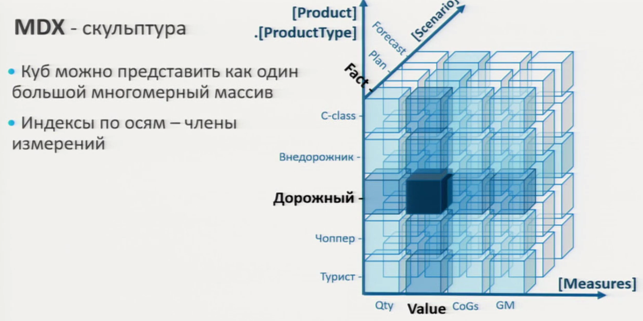
Creating Calculations and Queries by Using MDX
Understanding MDX syntax
DEMO

Slide 12
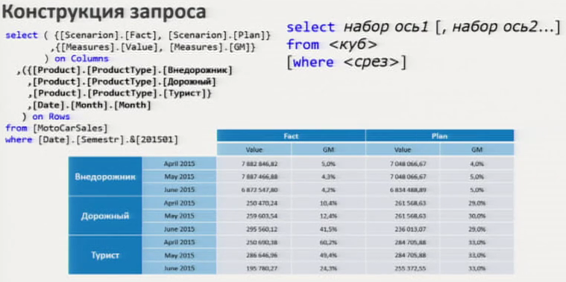
Creating Calculations and Queries by Using MDX
Understanding MDX syntax
DEMO

Slide 13
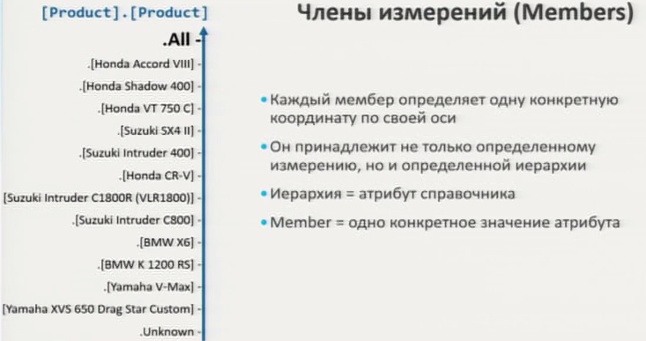
Creating Calculations and Queries by Using MDX
Understanding MDX syntax
DEMO

Slide 14
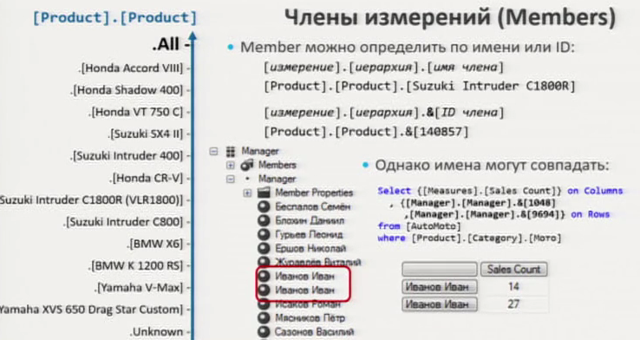
Creating Calculations and Queries by Using MDX
Understanding MDX syntax
DEMO

Slide 15
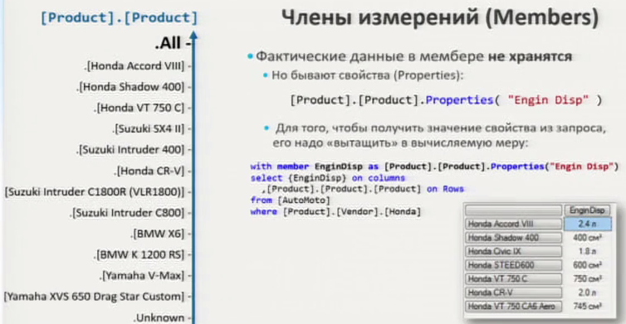
Creating Calculations and Queries by Using MDX
Understanding MDX syntax
DEMO

Slide 16
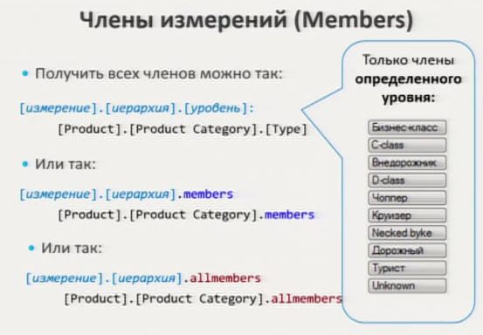
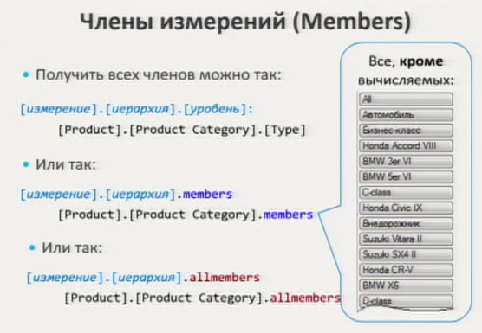
Creating Calculations and Queries by Using MDX
Understanding MDX syntax
DEMO

Slide 17
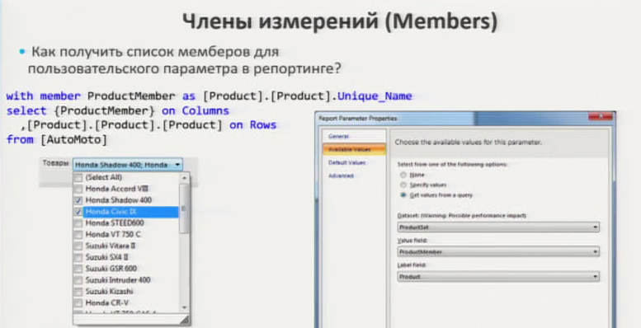
Creating Calculations and Queries by Using MDX
Understanding MDX syntax
DEMO

Slide 18
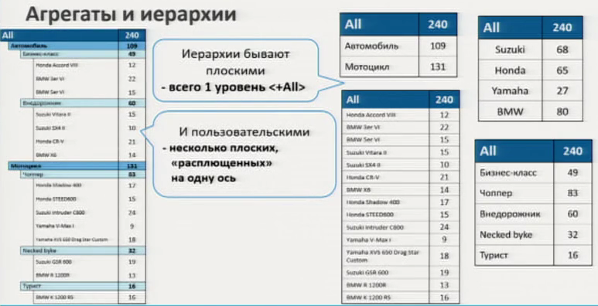
Creating Calculations and Queries by Using MDX
Understanding MDX syntax
DEMO

Slide 19
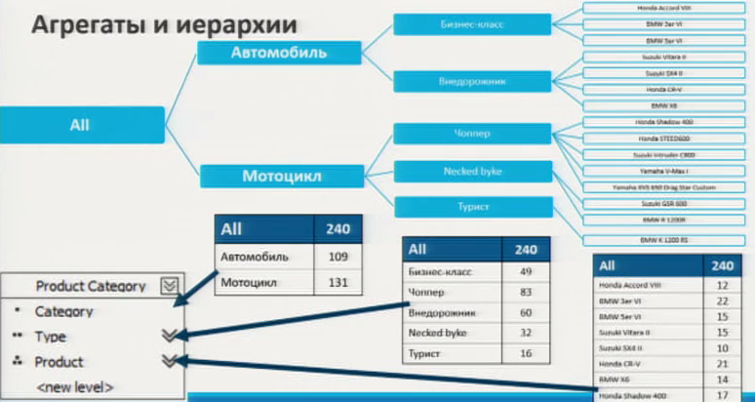
Creating Calculations and Queries by Using MDX
Understanding MDX syntax
DEMO

Slide 20
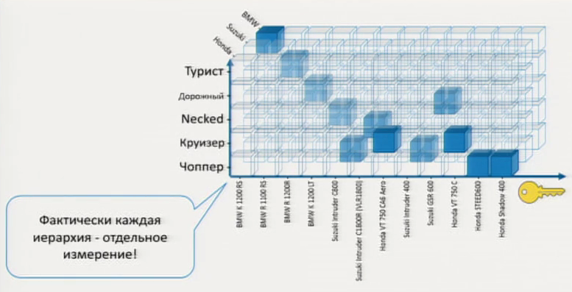
Creating Calculations and Queries by Using MDX
Understanding MDX syntax
DEMO

Slide 21
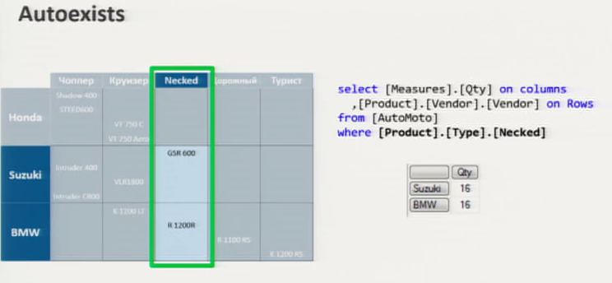
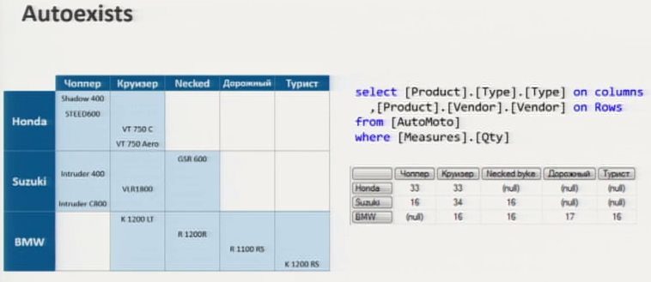
Creating Calculations and Queries by Using MDX
Understanding MDX syntax
DEMO

Slide 22
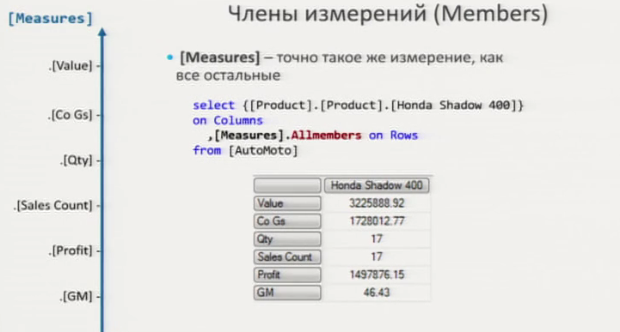
Creating Calculations and Queries by Using MDX
Understanding MDX syntax
DEMO

Slide 23
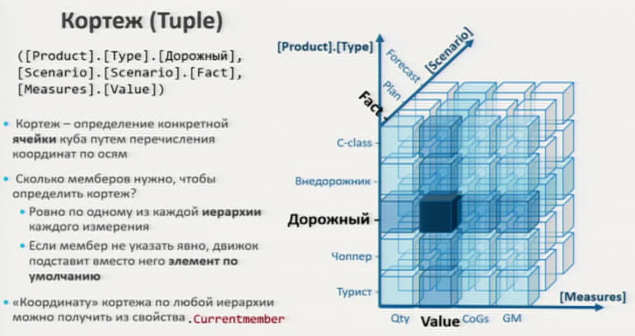
Creating Calculations and Queries by Using MDX
Understanding MDX syntax
DEMO

Slide 24
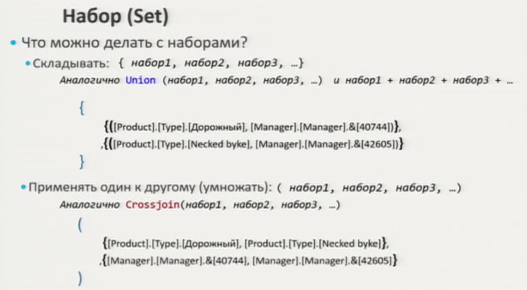
Creating Calculations and Queries by Using MDX
Understanding MDX syntax
DEMO

Slide 25
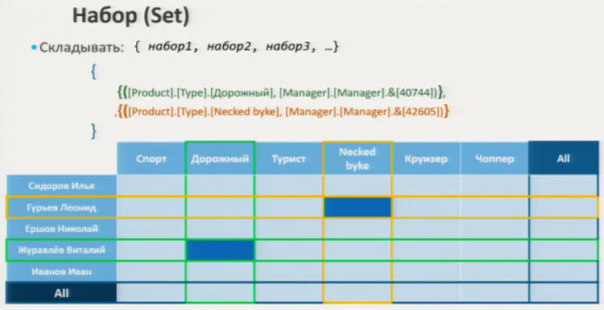
Creating Calculations and Queries by Using MDX
Understanding MDX syntax
DEMO

Slide 26
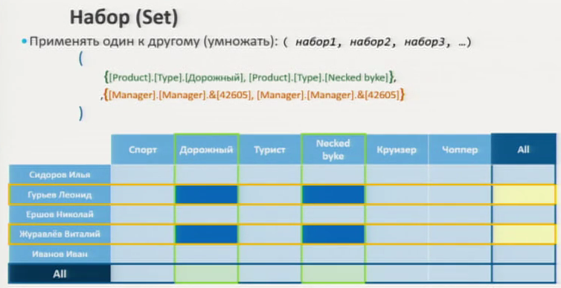
Creating Calculations and Queries by Using MDX
Understanding MDX syntax
DEMO

Slide 27
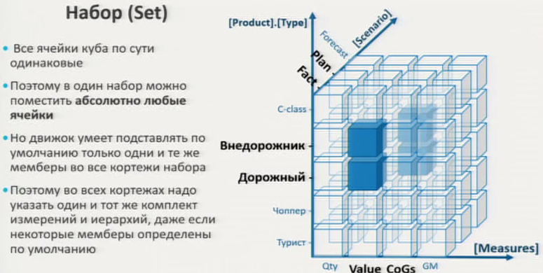
Creating Calculations and Queries by Using MDX
Understanding MDX syntax
DEMO

Slide 28
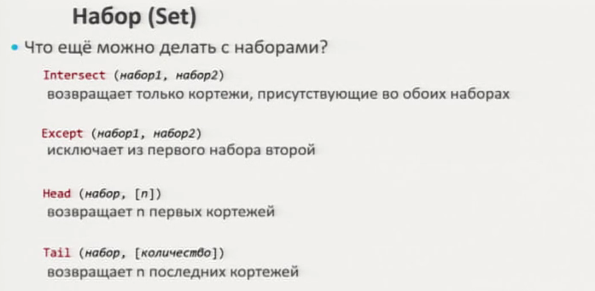
Creating Calculations and Queries by Using MDX
Understanding MDX syntax
DEMO

Slide 29
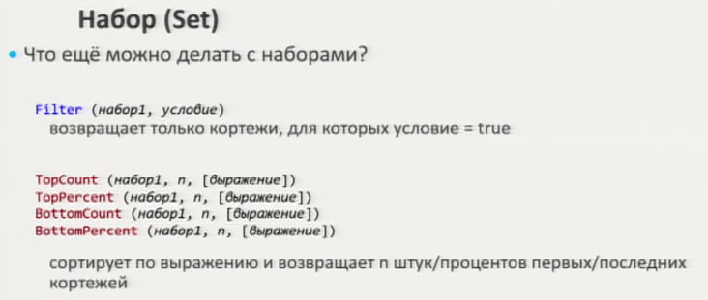
Creating Calculations and Queries by Using MDX
Understanding MDX syntax
DEMO

Slide 30
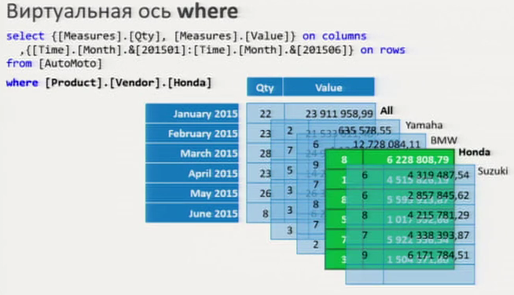
Creating Calculations and Queries by Using MDX
Understanding MDX syntax
DEMO

Slide 31
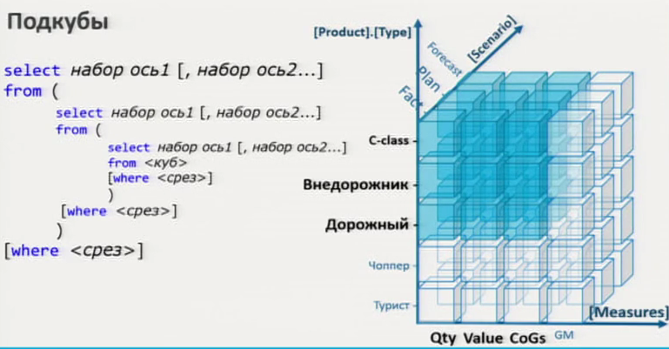
Creating Calculations and Queries by Using MDX
Understanding MDX syntax
DEMO

Slide 32
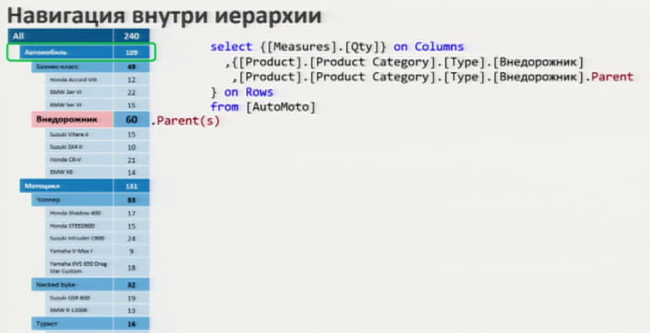
Creating Calculations and Queries by Using MDX
Understanding MDX syntax
DEMO

Slide 33
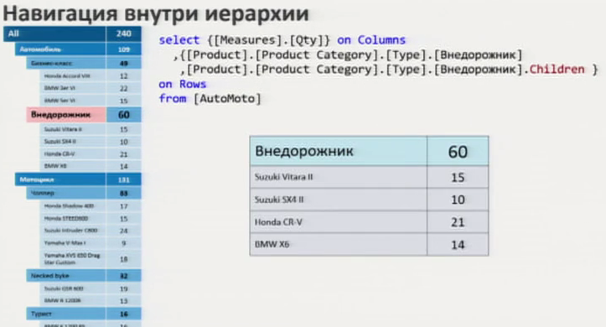
Creating Calculations and Queries by Using MDX
Understanding MDX syntax
DEMO

Slide 34
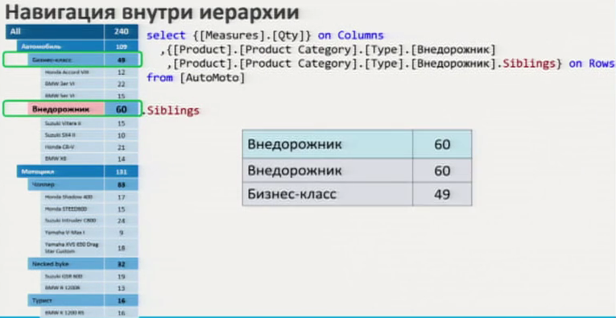
Creating Calculations and Queries by Using MDX
Understanding MDX syntax
DEMO

Slide 35
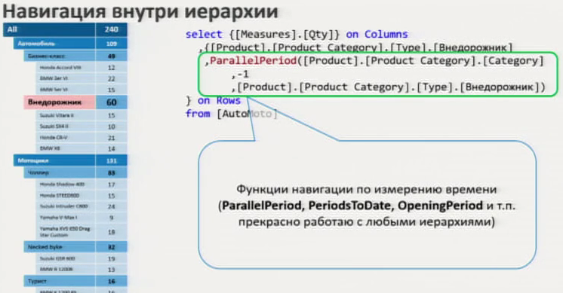
Creating Calculations and Queries by Using MDX
Understanding MDX syntax
DEMO

Slide 36
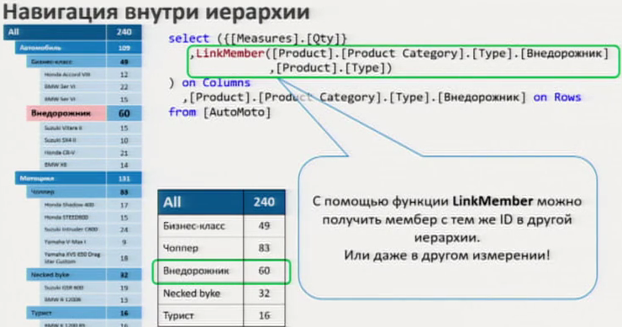
Creating Calculations and Queries by Using MDX
Understanding MDX syntax
DEMO

Slide 37
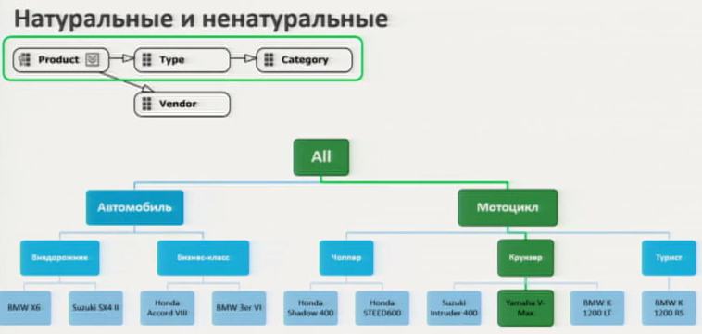
Creating Calculations and Queries by Using MDX
Understanding MDX syntax
DEMO

Slide 38
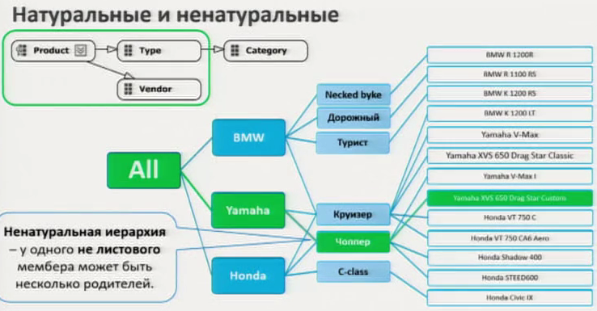
Creating Calculations and Queries by Using MDX
Understanding MDX syntax
DEMO

Slide 39
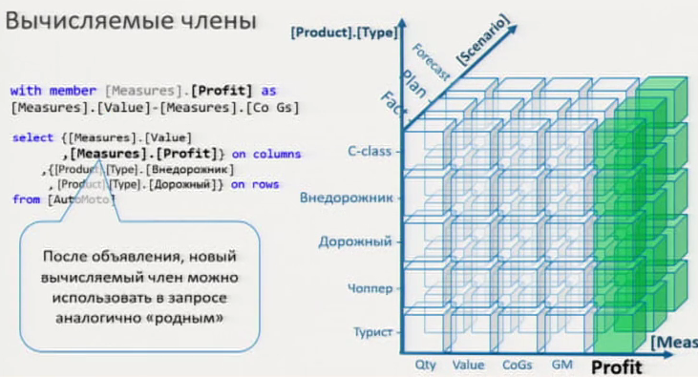
Creating Calculations and Queries by Using MDX
Understanding MDX syntax
DEMO

Slide 40
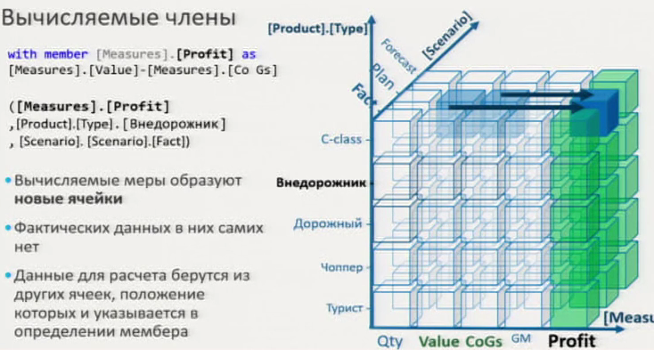
Creating Calculations and Queries by Using MDX
Understanding MDX syntax
DEMO

Slide 41
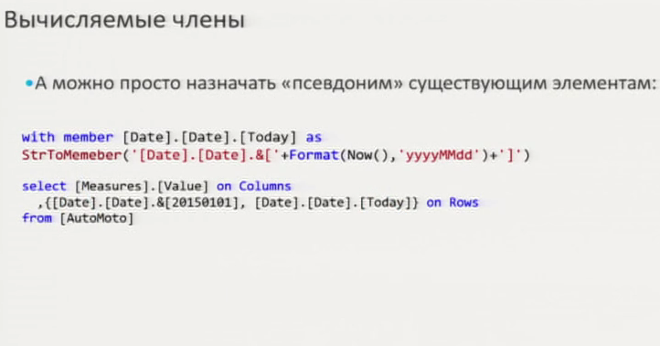
Creating Calculations and Queries by Using MDX
Understanding MDX syntax
DEMO

Slide 42
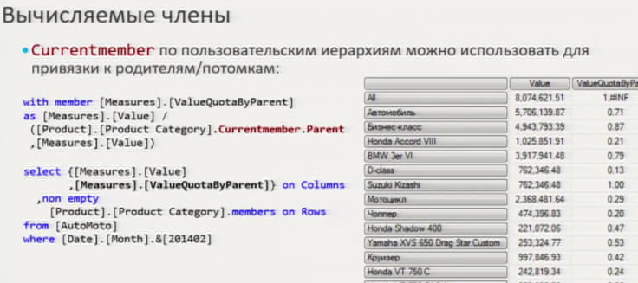
Creating Calculations and Queries by Using MDX
Understanding MDX syntax
DEMO

Slide 43
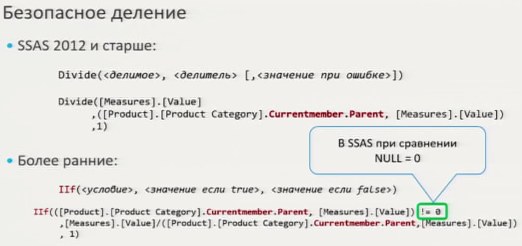
Creating Calculations and Queries by Using MDX
Understanding MDX syntax
DEMO

Slide 44
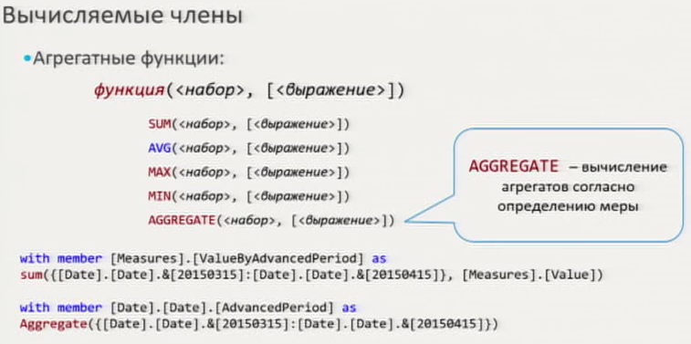
Creating Calculations and Queries by Using MDX
Understanding MDX syntax
DEMO

Slide 45
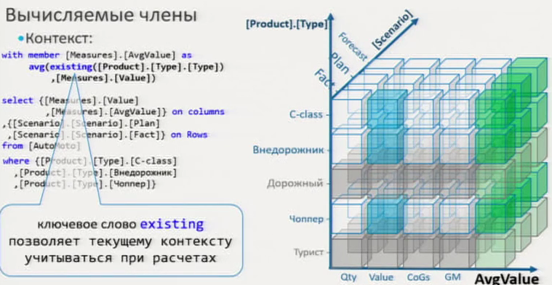
Creating Calculations and Queries by Using MDX
Understanding MDX syntax
DEMO

Slide 46
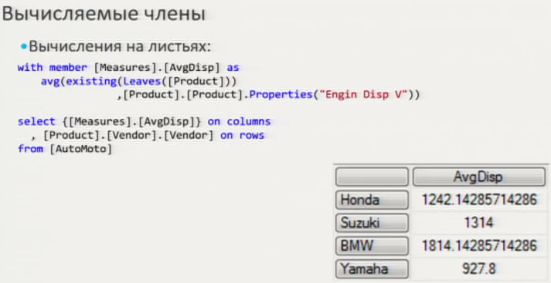
Creating Calculations and Queries by Using MDX
Understanding MDX syntax
DEMO

Slide 47
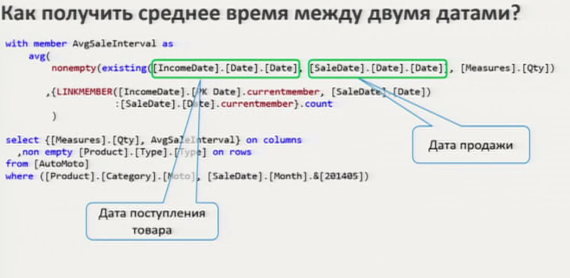
Creating Calculations and Queries by Using MDX
Understanding MDX syntax
DEMO

Slide 48
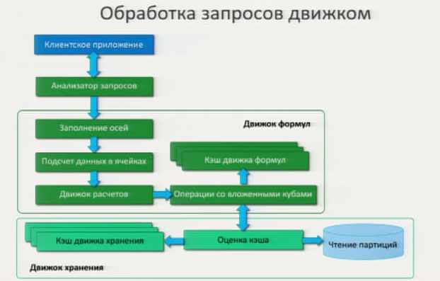
Creating Calculations and Queries by Using MDX
Understanding MDX syntax
DEMO

Slide 49
Creating Calculations and Queries by Using MDX
Applying MDX Functions

Slide 50
Creating Calculations and Queries by Using MDX
Applying MDX Functions
DEMO

Slide 51
Creating Calculations and Queries by Using MDX
Creating Calculated Members

Slide 52
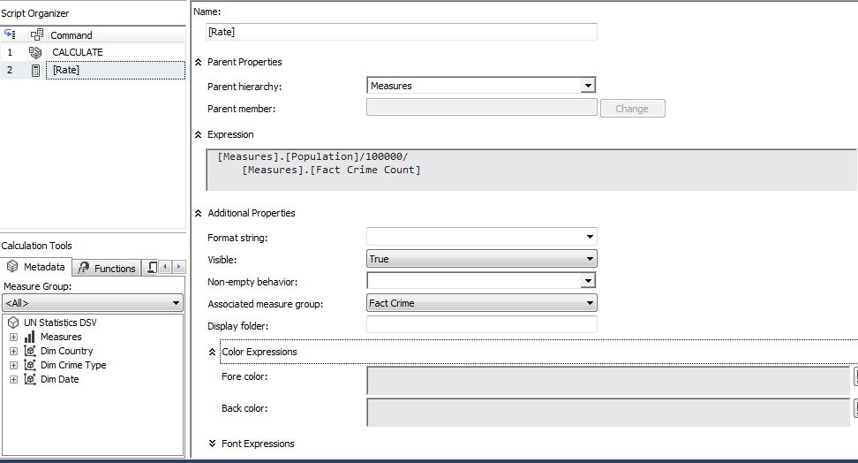
Creating Calculations and Queries by Using MDX
Creating Calculated Members
DEMO
Rate

Slide 53
Creating Calculations and Queries by Using MDX
Defining Named Sets

Slide 54
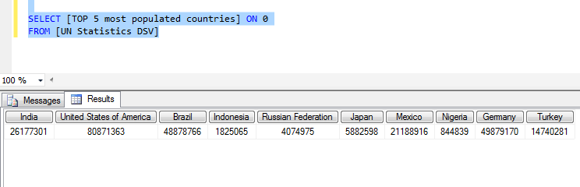
Creating Calculations and Queries by Using MDX
Defining Named Sets
DEMO
TOP 10 countries by population
Notes:
SELECT [Measures].[Population] ON columns,
({TOPCOUNT([Dim Country].[Geograhy].[Country].MEMBERS, 10, [Measures].[Population])}
,{[Dim Date].[Years].[Calendar Year].MEMBERS})
ON rows
FROM [UN Statistics DSV]

Slide 55
S16E24
Thank You!

